Slide 1
Marriage Equality
Team members:
Arianna, Monash University, PhD 1st year (I am sick :( )
Kate,
Liam
Sadia - CIS, PhD 2nd year
Tori,
Yichao - MDHS, PhD 3rd year

Slide 2
Marriage Equality:
Scenario: As data scientist analyze the marriage equality data
Goal: Explain interesting patterns in this data
Research Questions:
Which state supported this law strongly and which state supported it weakly?
Can gender be a describing factor for supporting this law?
What is the relation of age in participation of polling and which age group supported this law more strongly?

Slide 3
Marriage Equality:
Tool:
R and RStudio
Libraries(packages):
ggplot, ggplot2 for visualizations
dplyr,tidyr for data processing and formatting

Slide 4
Main ideas
Descriptive analysis
Basic statistics to introduce the data - e.g.bar plots
Interactive map (Shiny or something similar) to show the difference between states
Inferential analysis
Correlation between gender/age and Yes rate/participating in polling
Could look for predictions to compare to results

Slide 5
Actions? (please add)
Data cleaning: male and female data has duplicated entries...
Basic stats to introduce - e.g.some bar plots
Interactive map (Shiny or something similar)
Could look for predictions to compare to results

Slide 6
Who’s doing what?
Liam currently looking at map stuff
Kate - put yes and no by state into a table for later use(could be for a static map) - now I’m trying to correlate gender percentage with yes vote
Sadia - working on basic bar plots
Arianna - convert Electoral Division → State and then sort participation per State by age group
Yichao- run all the codes, make universal variable names and merge all commands into one file
Tori - gender and states

Slide 7
Duplicate removal
# lots of duplicates in the data so we first need to get our data clean
library(dplyr)
female = read_csv("C:/Users/Sadia/Desktop/OpenRes/ResponseFemale.csv")
male = read_csv("C:/Users/Sadia/Desktop/OpenRes/ResponseMale.csv")
total = read_csv("C:/Users/Sadia/Desktop/OpenRes/ResponseTotal.csv")
dup_free_female = distinct(female)
dup_free_male = distinct(male)
dup_free_total = distinct(total)

Slide 8
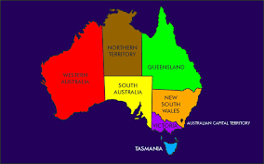

Slide 9
http://time.com/4561347/presidential-election-results-interactive/
Age
How Y/N changes for age groups in every state. The map is interactive.

Slide 10
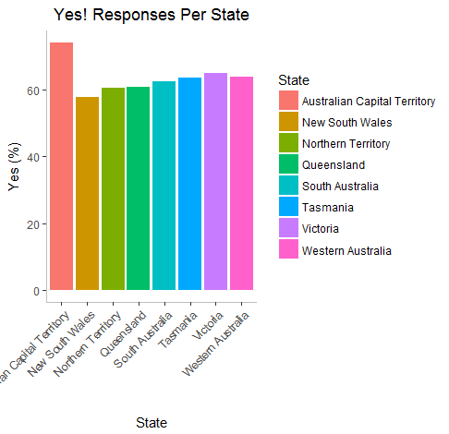
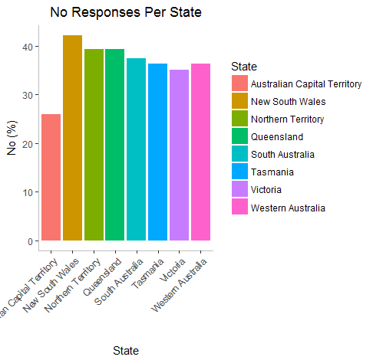
Kate - Code for Percentage of yes per state
library(dplyr)
onse <- read.csv("AMLPS_RESP_2017_17112017134913689.csv", header=TRUE, stringsAsFactors = FALSE)
statefilter = c("New South Wales","Victoria","Queensland","South Australia","Western Australia", "Northern Territory" ,"Tasmania", "Australian Capital Territory" )
response_by_state <- response %>%
filter(Federal.Electoral.Division %in% statefilter)
yes_by_state <- response_by_state[response_by_state$ï..RESPONSE_CAT== "RESPCLR_Y" & response_by_state$Measure== "Percentage (%)", c(8,11)]
yes_by_state%>%
ggplot()+
geom_bar(aes(x= Federal.Electoral.Division,y= Value , fill=Federal.Electoral.Division), stat = "identity") +
xlab("State") + ylab("Yes (%)") +
ggtitle("Yes! Responses Per State")+
theme_classic()+
theme(axis.text.x = element_text(angle = 45, hjust = 1))+
theme( plot.title = element_text(hjust=0.5) )+
theme(panel.border = element_blank(), panel.grid.major = element_blank(), panel.grid.minor = element_blank(), axis.line = element_line(colour = "grey"))+
theme(panel.border = element_blank(), axis.line.y = element_line(colour = "grey"))+
scale_fill_discrete(name = "State")
##No
yes_by_state[-8, ]
no_by_state <- response_by_state[response_by_state$ï..RESPONSE_CAT== "RESPCLR_N" & response_by_state$Measure== "Percentage (%)", c(8,11)]
no_by_state%>%
ggplot()+
geom_bar(aes(x= Federal.Electoral.Division,y= Value , fill=Federal.Electoral.Division), stat = "identity") +
xlab("State") + ylab("No (%)") +
ggtitle("No Responses Per State")+
theme_classic()+
theme(axis.text.x = element_text(angle = 45, hjust = 1))+
theme( plot.title = element_text(hjust=0.5) )+
theme(panel.border = element_blank(), panel.grid.major = element_blank(), panel.grid.minor = element_blank(), axis.line = element_line(colour = "grey"))+
theme(panel.border = element_blank(), axis.line.y = element_line(colour = "grey")) +
scale_fill_discrete(name = "State")
#Ideas for changing plot
#Order from highest to lowest plot

Slide 11
Links to other ideas
Predictions and an interactive
http://www.abc.net.au/news/2017-10-06/same-sex-marriage-result-calculator/8856294

Slide 12
Code for response by gender and states
library(dplyr)
states <- c('Victoria (Total)','New South Wales (Total)', 'Queensland (Total)',
'South Australia (Total)', 'Western Australia (Total)', 'Tasmania (Total)',
'Northern Territory (Total)', 'Australian Capital Territory (Total)')
ResponseFemale$Gender <- 'F'
ResponseMale$Gender <- 'M'
ResponseFemale2 <- select(ResponseFemale, -18)
ResponseMale2 <- select(ResponseMale, -18)
ResponseFM <- rbind(ResponseFemale2, ResponseMale2)
StatesGender <- ResponseFM %>%
group_by(FederalElectoralDivison) %>%
filter(FederalElectoralDivison %in% states)
StatesGender2 <- StatesGender %>% distinct()

Slide 13
Code for Percentage of yes/no per state (Sadia)
library(dplyr)
AMLPS = read_csv("C:/Users/Sadia/Desktop/OpenRes/AMLPS_RESP_2017_17112017134913689.csv")
state = c("New South Wales", "Victoria", "Queensland", "South Australia",
"Western Australia", "Tasmania", "Northern Territory",
"Australian Capital Territory", "Australia")
test_ampls = AMLPS %>%
filter(Response %in% c("Response clear - Total", "Response clear - Yes", "Response clear - No")) %>%
filter(Measure == 'Percentage (%)' & `Federal Electoral Division` %in% state)
yes <- test_ampls[which(test_ampls$Response == "Response clear - Yes"),]
no <- test_ampls[which(test_ampls$Response == "Response clear - No"),]

Slide 14
Age groups: Sadia
Under 25
25-35
35-45
45-60
Above 60

Slide 15
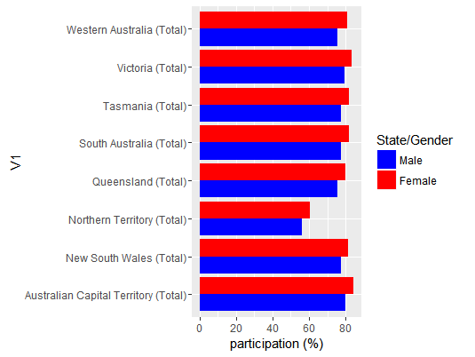
Per state participation (Sadia)
#file read
female = read_csv("C:/Users/Sadia/Desktop/OpenRes/ResponseFemale.csv")
male = read_csv("C:/Users/Sadia/Desktop/OpenRes/ResponseMale.csv")
# duplicate removal
dup_free_female = distinct(female)
dup_free_male = distinct(male)
states = c("New South Wales (Total)", "Victoria (Total)", "Queensland (Total)", "South Australia (Total)",
"Western Australia (Total)", "Tasmania (Total)", "Northern Territory (Total)",
"Australian Capital Territory (Total)", "Australia (Total)")
# data selection
test_m = dup_free_male %>%
filter(FederalElectoralDivison %in% states, Participation %in% "Participation rate (%)")
test_fm = dup_free_female %>%
filter(FederalElectoralDivison %in% states, Participation %in% "Participation rate (%)")
# get % participation response
a_m = test_m %>%
filter(Participation == "Participation rate (%)")
a_fm = test_fm %>%
filter(Participation == "Participation rate (%)")
for_plot = cbind(a_m$FederalElectoralDivison,a_m$Total.Males.b.,a_fm$Total.Females.b.)
for_plot = as.data.frame(for_plot)
for_plot$V2 = as.numeric(as.character(for_plot$V2))
for_plot$V3 = as.numeric(as.character(for_plot$V3))
library(tidyr)
for_plot %>%
gather(V2,V3,key='gender',value="participation (%)") %>%
ggplot() +
geom_bar(aes(y=`participation (%)`,x=V1, fill=gender),stat = 'identity',position = "dodge")+
coord_flip()+
scale_fill_manual(values = c("blue", "Red"), name = "State/Gender", labels = c("Male ","Female"))

Slide 16
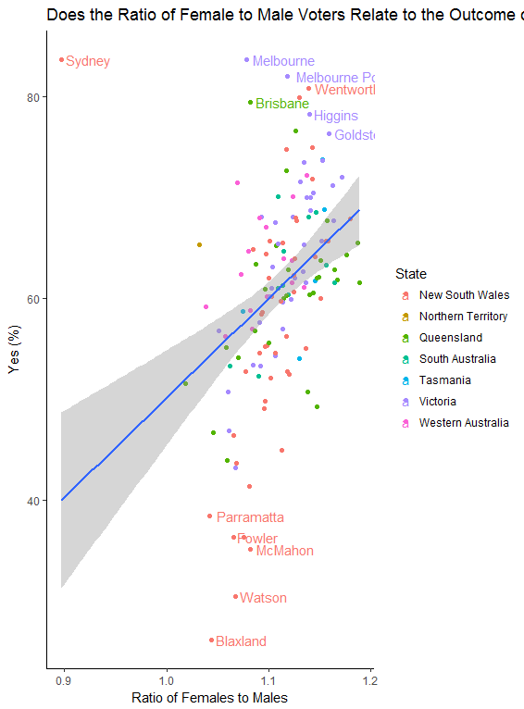
Found a significant relationship between gender ratio of those who participated and the outcome in the electorate. The more women that participated compared to men, the higher the rate of YES votes.
Outliers of note: Sydney - lower female ratio of participation but still very high yes votes.
Disclaimer: Of course cannot say that women voted yes more, as we do not have that data. There could be other variables involved (such as urban versus rural, age etc.) that influence both gender ratios and yes voting.
But still quite interesting! :)
Attached code on the word doc

Slide 17
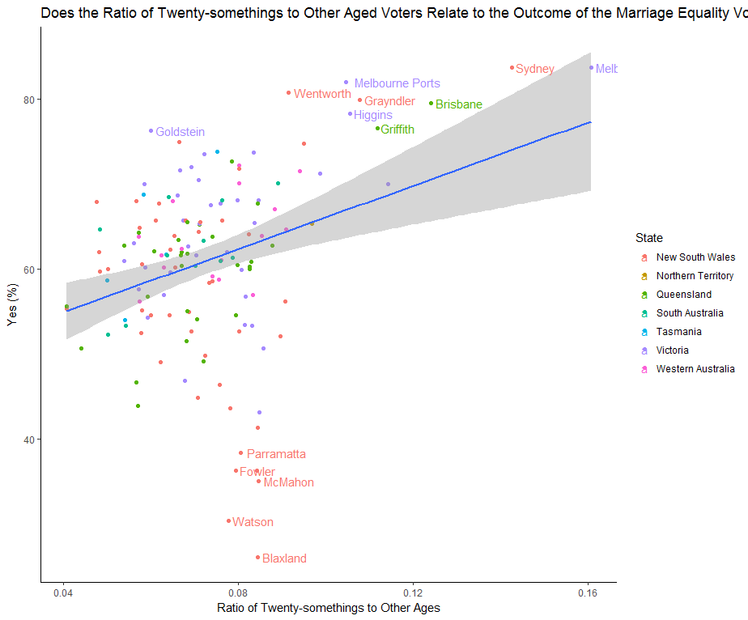
This plot looks at the rate of 25-29 year olds compared to other age groups and whether that is related to YES votes.
The higher the amount of 25-29yr-olds in an electorate the higher the rate of YES votes.
Another take-away from this graph is that it looks like NSW may be a polarised state: has some of the highest and lowest rates of YES voting

Slide 18
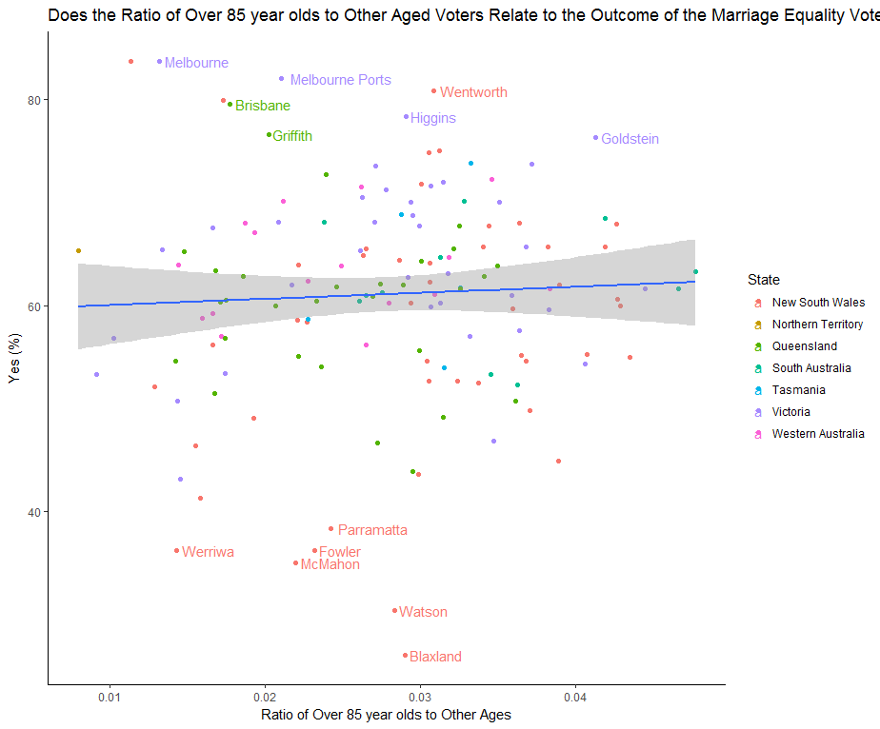
Finally I examined whether the amount of the oldest Australians (over 85) voting in an electorate influenced the YES vote.
There was no relationship with the levels of over 85s and the outcome.

Slide 19
Code for mapping
## install.packages("")
library(dplyr)
library(rgdal)
library(tmap)
#---------------------------------------------------------------------------#
### Call data
total <- read.csv("ResponseTotal.csv")
map <- readOGR(dsn="101_electoral_boundaries/COM20111216_ELB_region.shp",layer="COM20111216_ELB_region")
# lots of duplicates in the data so we first need to get our data clean
dup_free_female = distinct(female)
dup_free_male = distinct(male)
dup_free_total = distinct(total)
# Find out what variables are measures
unique(total$Participation)
# Filter on different measurement parametes
total_sub <- dup_free_total[which(dup_free_total$Participation == "Participation rate (%)"),]
# Make column names the same to merge
total$ELECT_DIV <- total$FederalElectoralDivison
# Merge data
map1 <- merge(map, total_sub, by = "ELECT_DIV")
# Filter on state
map_vic <- map1[which(map1$STATE == "VIC"),]
# find variables
names(map1)
# Create map using 'fill' to define the variable
qtm(shp = map_vic, fill = "X18.19.years", fill.palette = "-Blues")
qtm(shp = map_vic, fill = c("X18.19.years", "X75.79.years"), fill.palette = "Blues", ncol = 2)

Slide 20
